Slide 1
Planning and placement
How do you deploy and place your acoustic sensors to most effectively exploit their capacity?

Slide 2
Planning a deployment
How many sensors do you have available?
  Is the acoustic sensor accompanied by other sensor technologies?
How will you power your sensors?
  And how will you network them?
What object is to be protected?
  Bigger objects will demand more sensors to be fully covered
What is the most probable incoming direction?
  Prioritize your available sensors in the direction drones most likely will come from
What is the threat?
  Expected range:
    Petrol powered fixed wings: > 1 km
    Quad copters and electric fixed wings: < 500 m
An earlier warning can be obtained by placing the sensor at a longer distance from the protected object
  This might demand more sensors to insure there are no gaps in the perimeter
  Remember, the sensor detects drones within a sector of 105°

Slide 3
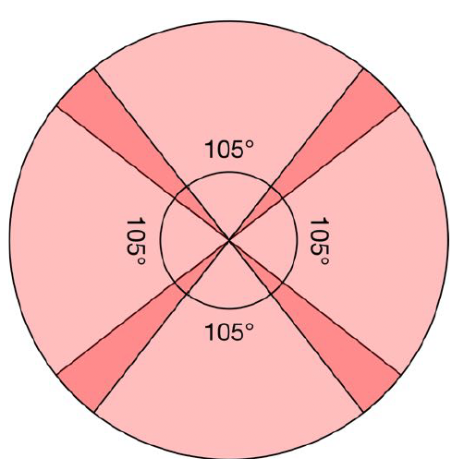
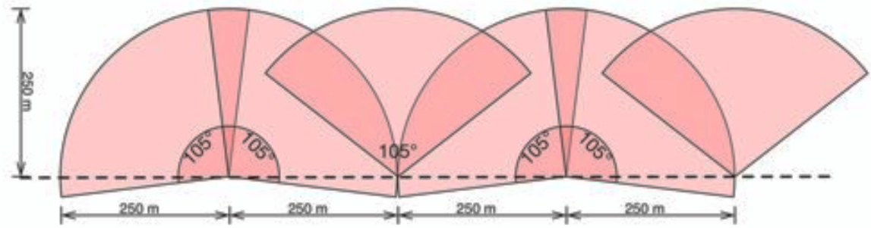
Deployment methods
360 coverage
Perimeter

Slide 4
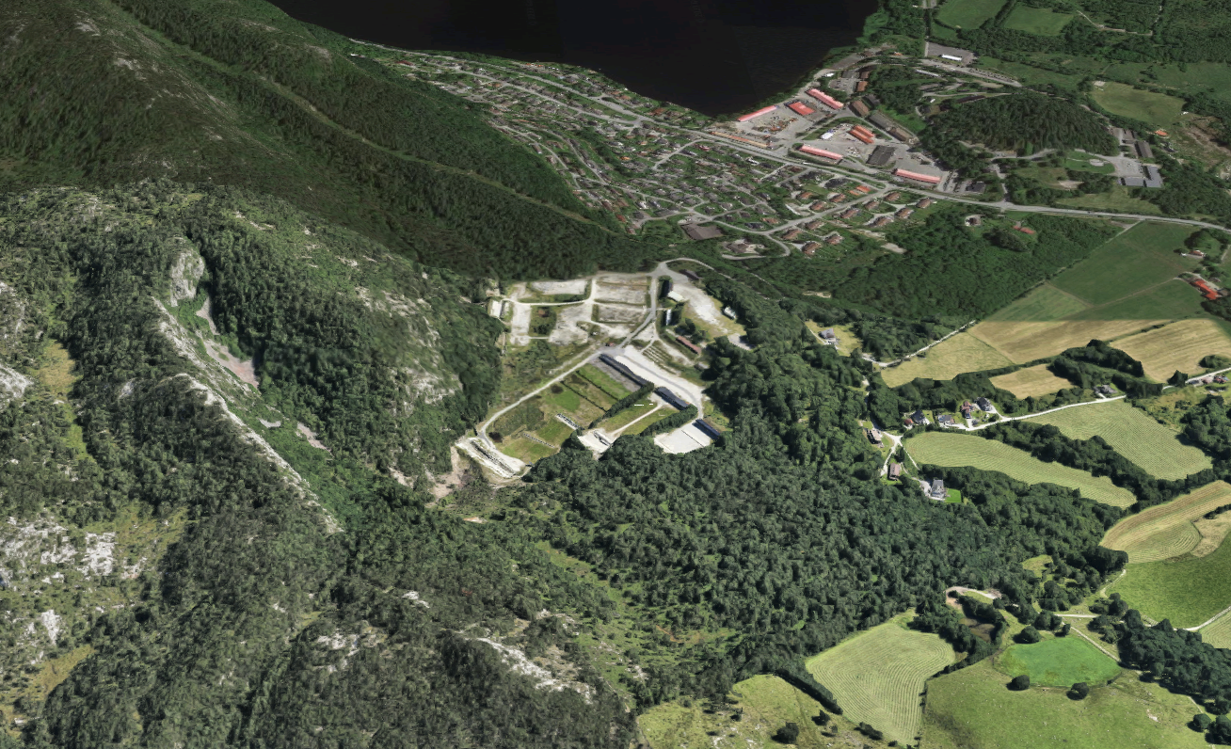
Vatne skytebane

Slide 5
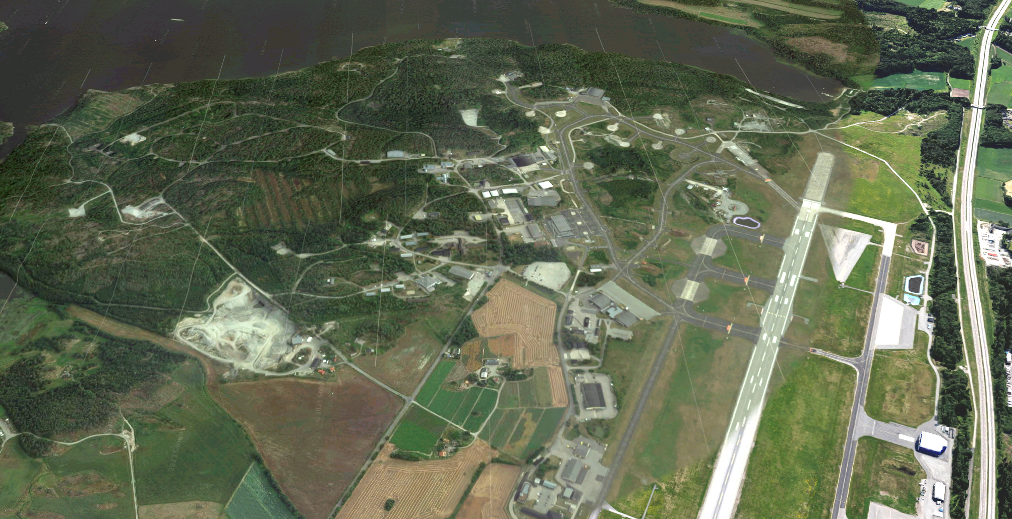
Rygge

Slide 6
Technical placement
Baffle on at all times
Avoid nearby noise sources
Suppress wind, place low
Shield from ambient noise

Slide 7
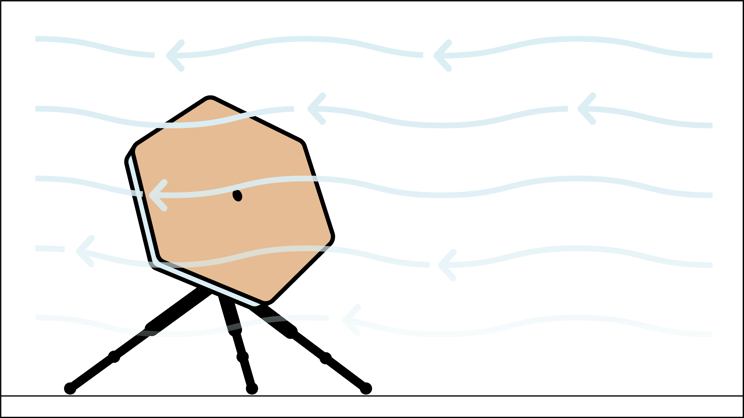
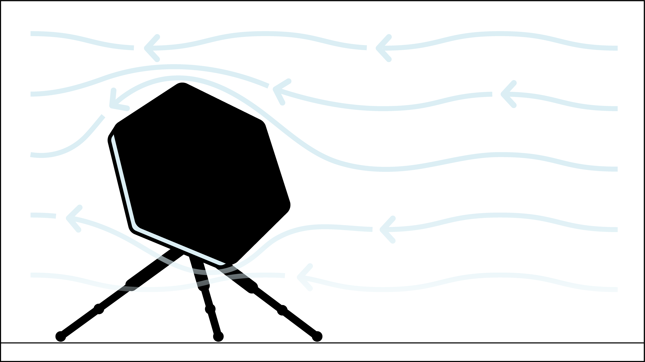


Baffle on at all times
Wind generates noise in the microphones
The baffle muffles the wind noise

Slide 8
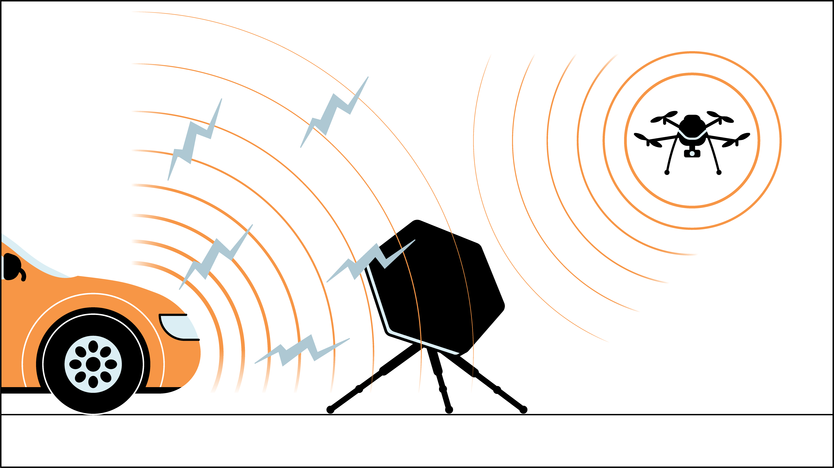
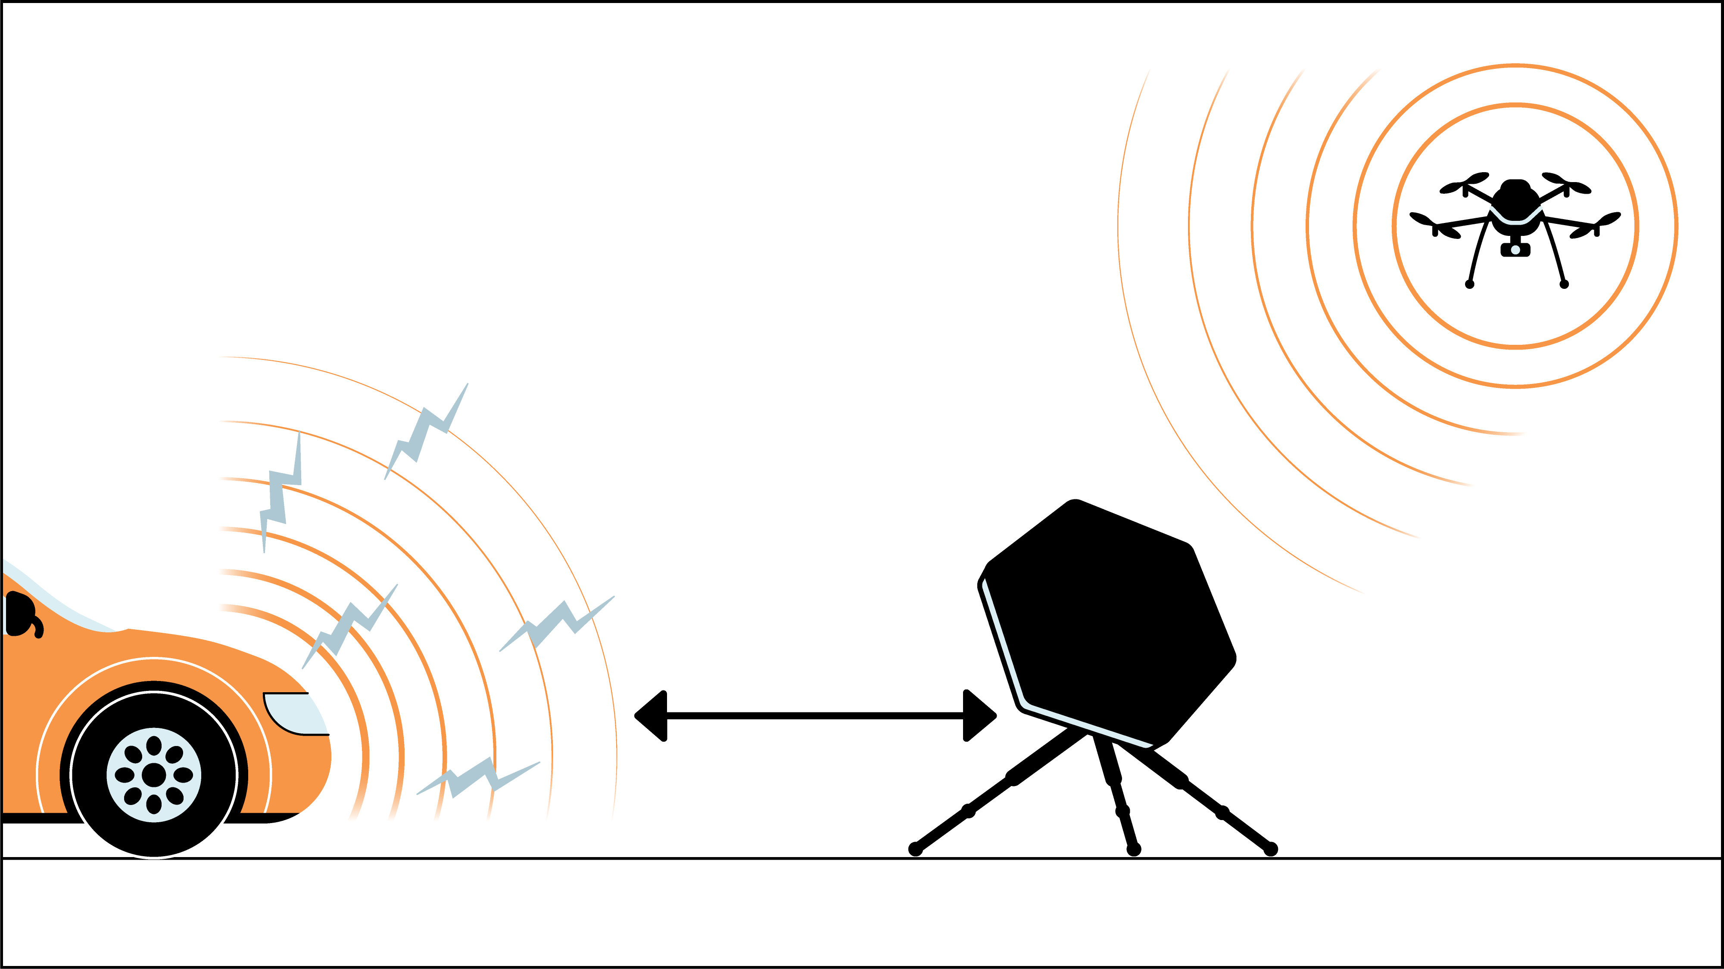
Avoid nearby noise sources
An increase in the ambient noise level around the array will decrease the arrays detection range
Place the array away from the noise source
Remove the noise source if possible
Detection range increases logarithmically in relation to distance from noise sources.

Slide 9
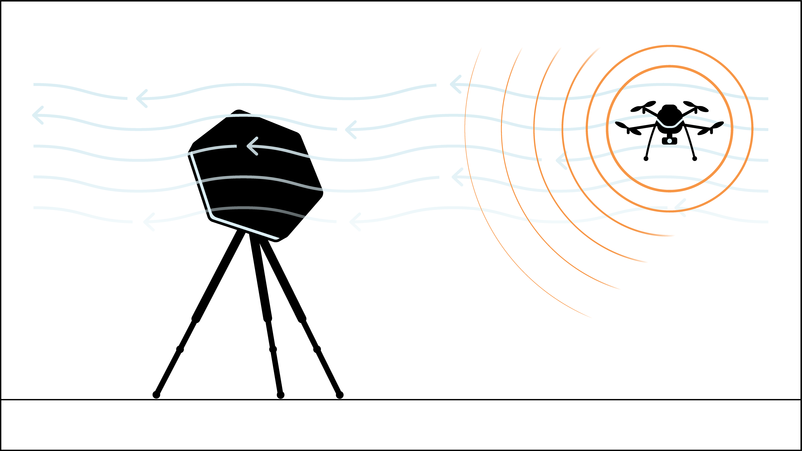
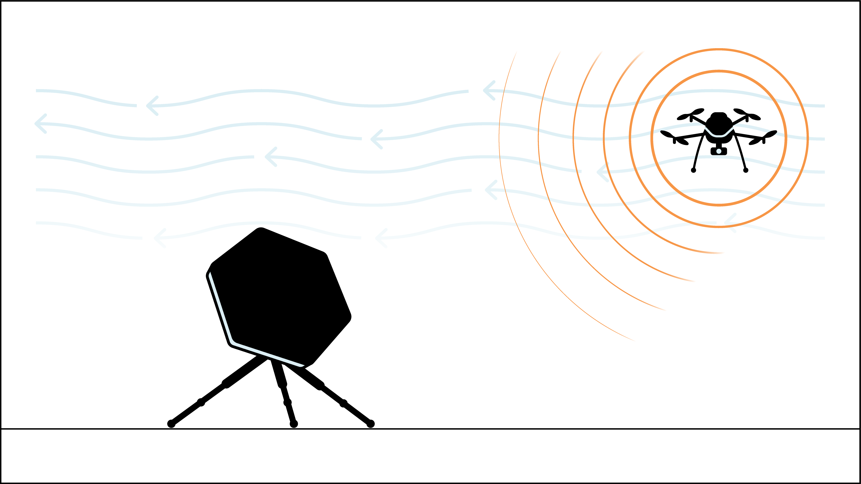
Suppress wind, place low
The wind tend to be weaker, and thereby less noisy, closer to the ground
Try placing the array as close to the ground as possible, without obstructing the microphones

Slide 10
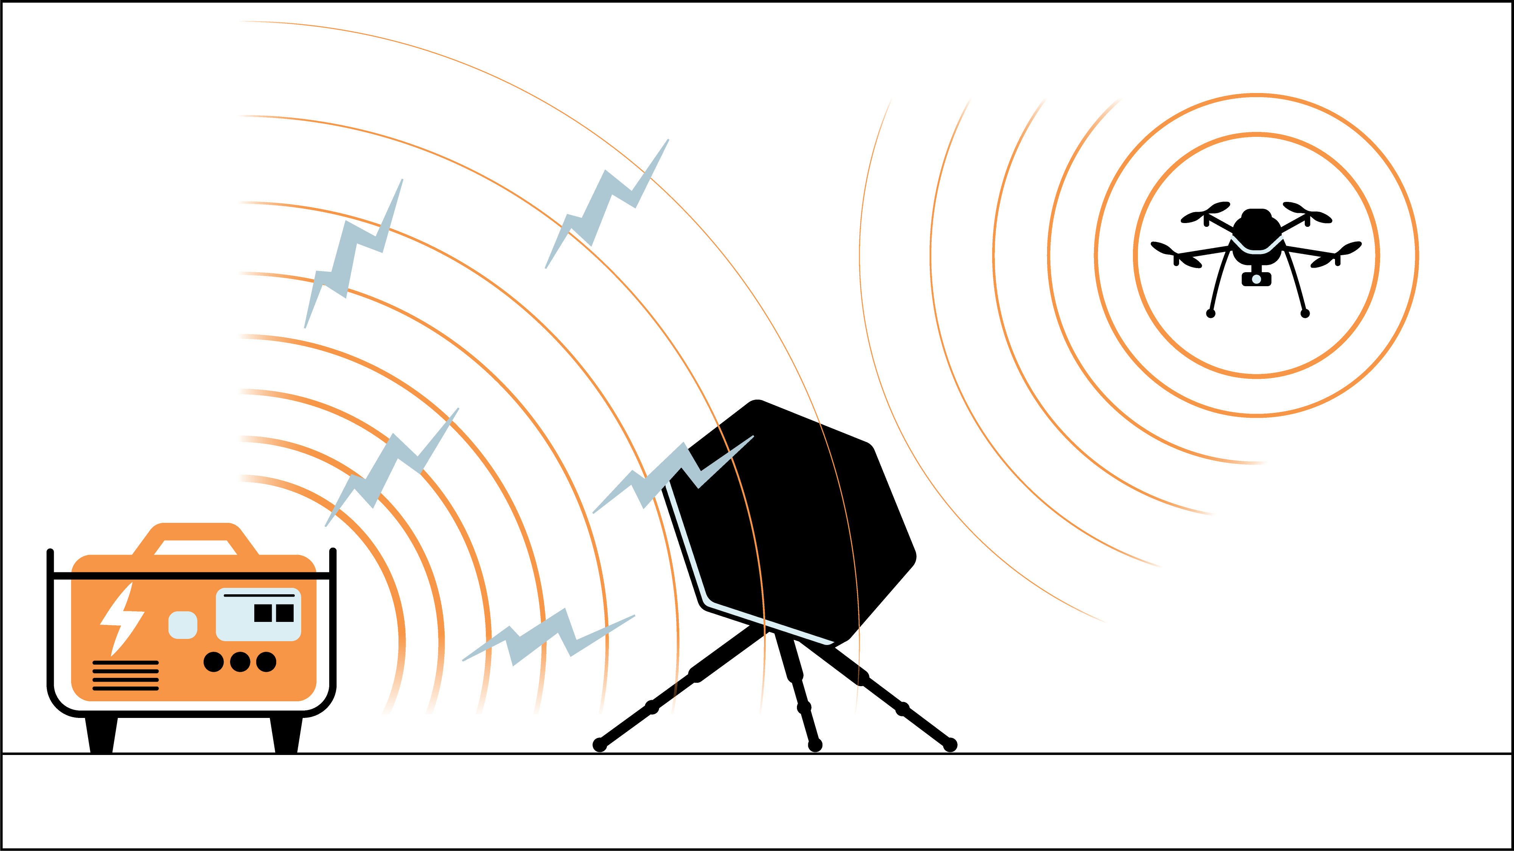
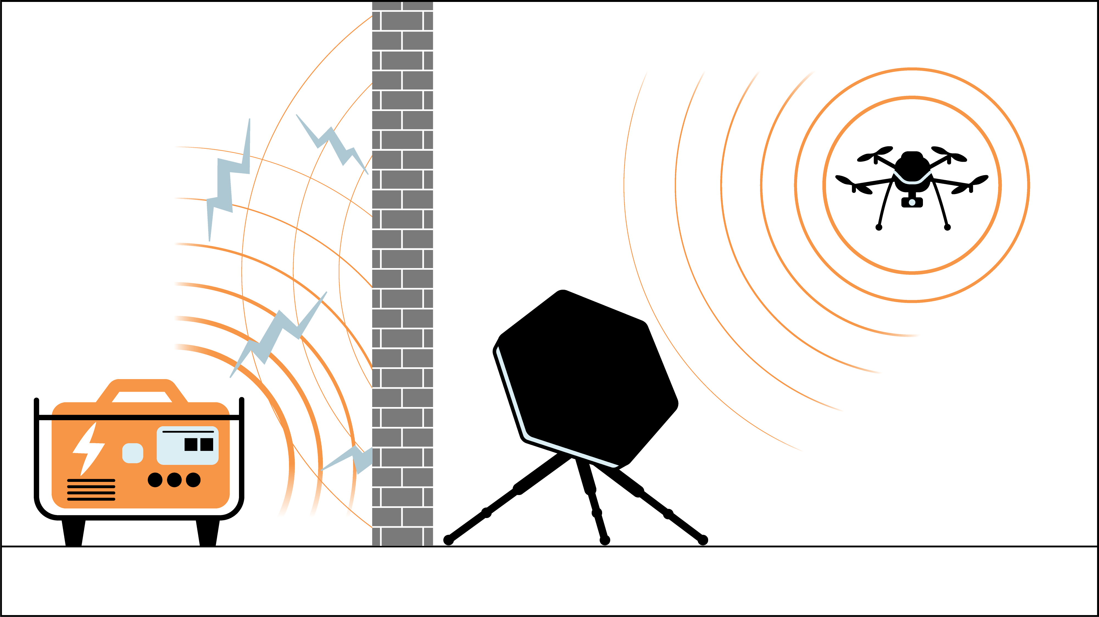
Shield from ambient noise
An increase in the ambient noise level around the array will decrease the arrays detection range
Shield the sensor from the noise source to reduce background noise

Slide 11
Typical noise sources
Vehicles
Roads
Generators
Air condition/fans
People talking
Vegetation
Possible isolators
Natural terrain, hills, rocks
Vehicles (that aren’t running)
Walls
Buildings (that don’t make noise)

Slide 12
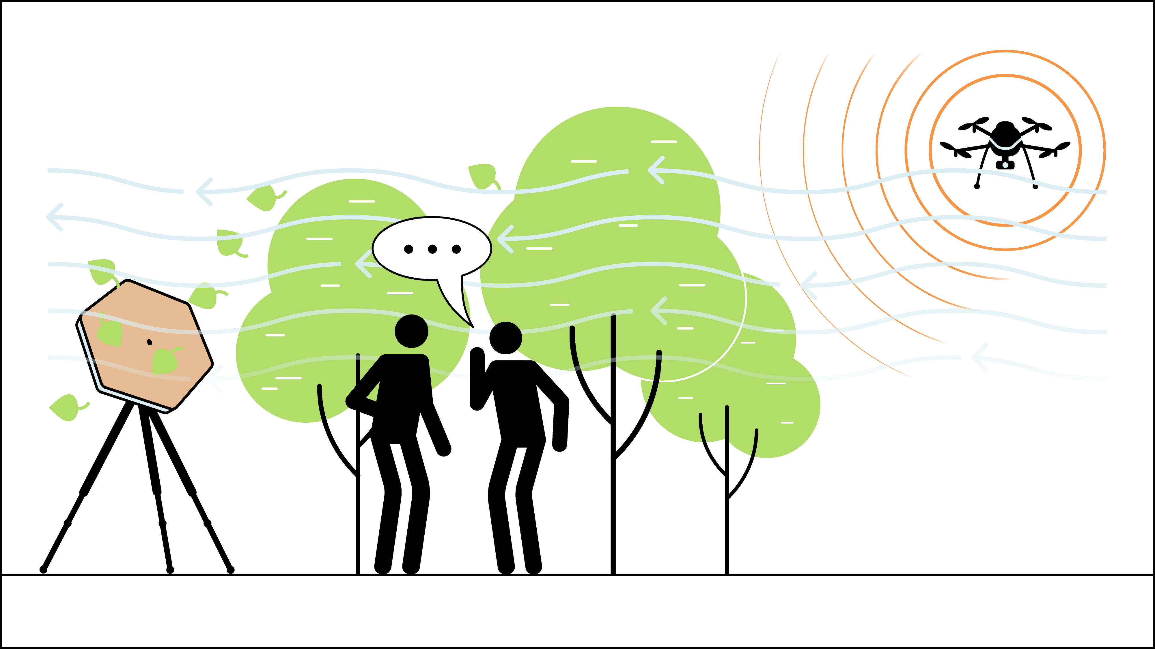
What’s wrong with this placement?

Slide 13
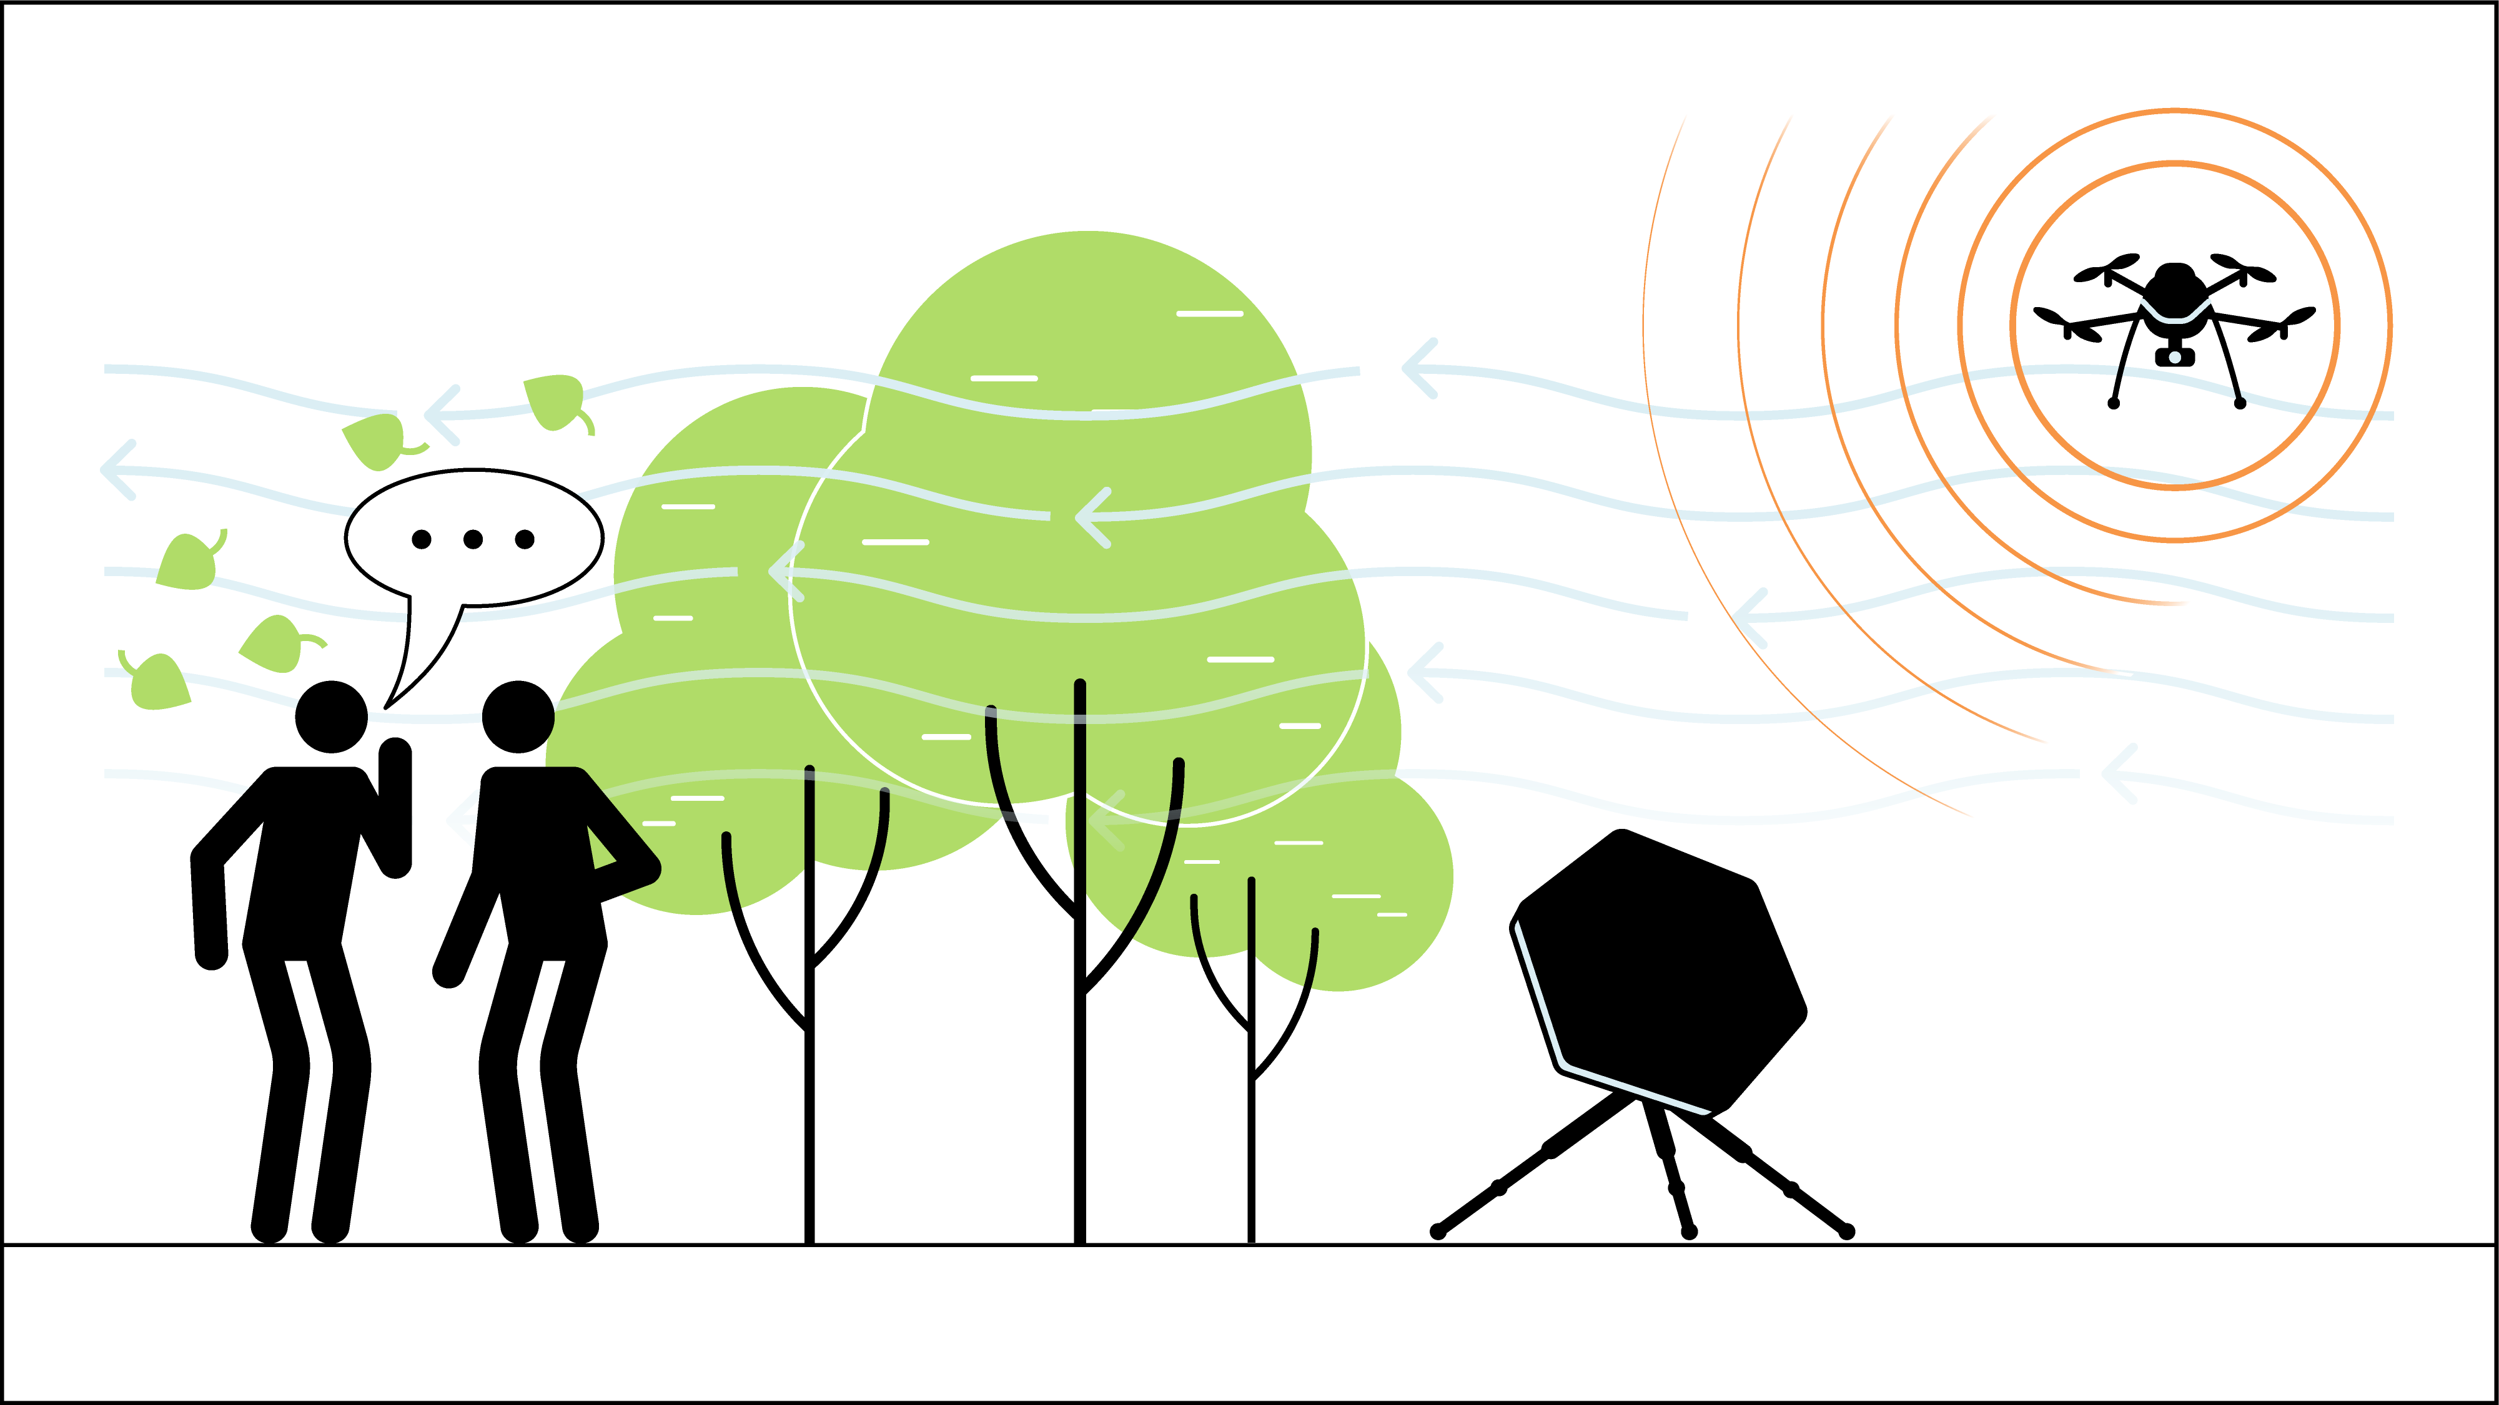
Solution

Slide 14
B.A.S.S
Baffle on at all times
Avoid nearby noise sources
Suppress wind, place low
Shield from ambient noise

